Slide 1

Mount Auburn
Practice Improvement Project
(MA-PIP)
Coach/Practice Manager Session
Jan 29, 2016

Slide 2
Agenda
Introductions: What is your practice working on? | 20 minutes
Exploring the Model for Improvement: Walking through a sample project together | 75 minutes
Next Steps: What will you do when you get back to your practice improvement project? | 25 minutes

Slide 3
Introductions
Very quickly (30-45 secs) tell us:
What is your improvement project? What do you think your next step will be?
What do you hope to gain/learn from this session?

Slide 4
Exploring the Model for Improvement:
Walking through a sample project
The following slides walk you through an example from:
  Hunch - Front desk calls is a good area for improvement
  Getting to Baseline – Figuring out what is currently going on using just enough data
  Selecting something to improve – Pick a subset to improve
    When to use Flow Charts
    Engage Patients
  Using the Model For Improvement Framework – Work through the 3 questions and Plan, Do, Study, Act
    Aims, Measures, Changes
    When to use the PDSA Form (Hint: with your team!)
  Sustaining Change
You can use this as a guide to navigate your own patient safety projects.

Slide 5
As we do this, we need to be sure we are:
Engaging patients
Focusing on safety for the patients

Slide 6
Engaging Patients
How do we engage patients in this work?
Patients’ perspective – identifying defects
Patients’ suggestions for improvements
Patients’ reaction to changes tested
Patients on your improvement team
“The greatest asset we have underutilized is
all the assets of the patient.”
Maureen Bisognano
President and CEO
Institute for Healthcare Improvement

Slide 7
Focusing on safety for the patients:
Generating Ideas for Patient Safety
Ideas:
Patient Safety as the first topic at staff meetings-
  “Do you have any concerns about patient safety that we should talk about?”
Record “pain points” and patient safety problems for future work/improvement projects
Involve patients in work to improve safety.
Example: When MAMA discovered that there is no systemic way to track patients who need colonoscopies on a 3 – 5 year schedule.

Slide 8
Tasks for the Coaches
Marguerite – Where in this process can we get patient input?
Susan – Have we gotten to the step where the patient receives the correct follow-up?
Sonya – What are we measuring to make sure the change is an improvement?
Lora – What can we use to make a run chart?

Slide 9
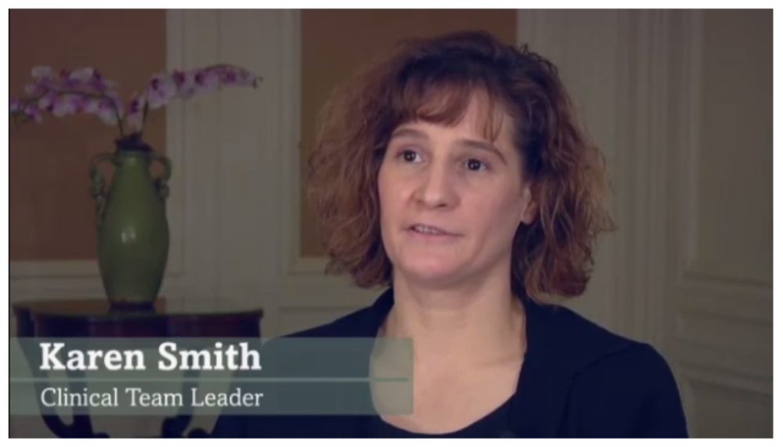
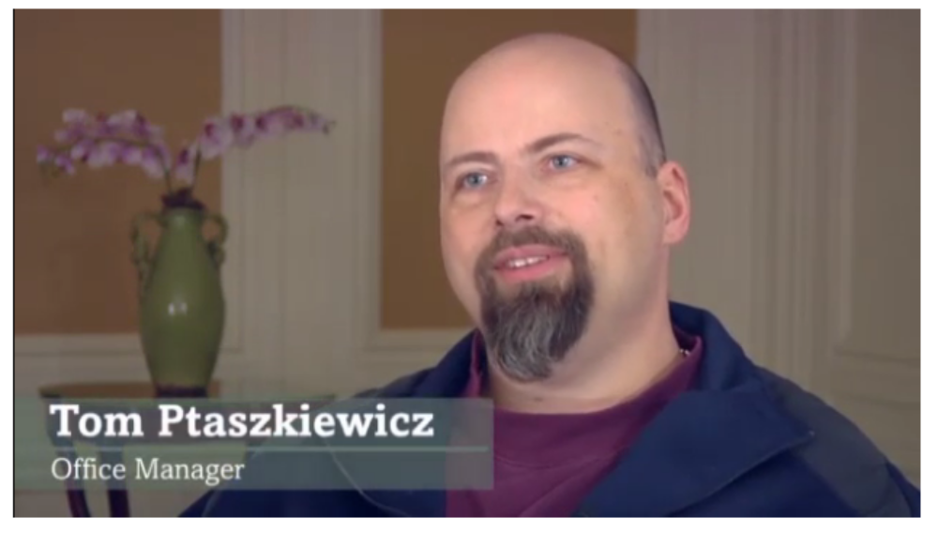
Case Study
Atkinson Family Practice
January, 2016

Slide 10
Meet Karen and Tom
When I met Karen and Tom, they had signed up to do an improvement project but had not heard of the Model For Improvement (MFI)
They did, however, have a project in mind…way too many calls the front desk was taking were from irate patients asking for prescription refills.

Slide 11
From Hunch to
Aim Statement
Time: 7 min
Cumulative Time: 12 min

Slide 12

They had a hunch
Tom - Patients were calling up “screaming at us” because they needed refills.
Karen – we were staying late to fill up to 30 refills at the end of the day because we had a strict rule of filling within 24 hours.
Hunch – too many patients were calling for re-fills.
Let data guide you – Get a baseline
D
A
T
A
Notes:
Be careful of
“urban legends”

Slide 13
Group Discussion 1 (5 minutes)
3 minutes to discuss, 2 to report out
If you have similar issue at your practice, what have you tried to make things better?

Slide 14
How much Baseline Data?
Time: 7 min
Cumulative 19 min

Slide 15

About collecting data
Hint - You only need a bit of data.
  Perhaps collect data for 1 hour on a Monday morning then for 1 hour on a Wednesday afternoon.
  Just collecting data on pen and paper would do.
  Project what that means for an average day
What do you think they found?

Slide 16
Group Discussion 2 (4 minutes)
2 minutes to discuss, 2 to report out
If you were in their shoes, what data would you collect?
What would you guess the data will tell them?

Slide 17
Getting to Baseline
Karen tracked (on a piece of paper):
  How many scripts were coming in for each patients
  Was it the same medication versus a brand new script
  Which pharmacy was sending it, how often
  How many times was the request coming from a patient versus how many times was it coming from a pharmacy
Date | Pt name | Script name | New? | From Pharmacy | From Patient
Jan 7 | Joe | ABC | No

Slide 18
Selecting something to improve
Time: 10 min
Cumulative 29 min

Slide 19

Use a High Level Flow Chart
Using a high level flow chart can help identify what to improve.
Typically, you will want to segment the process flow into 5 – 7 steps. Such as:

Slide 20
Select a subset to improve
Refill request
Still valid?
Call/efax into Pharmacy
Pharm calls Pt to pickup
Patient picks up Rx
Contact the small pharmacy
This particular example is using different colors for different participants in the process.
Much to Tom and Karen’s surprise, the calls were from pharmacies. And, of the pharmacies, mostly from a small local pharmacy not Costco or Walmart.

Slide 21
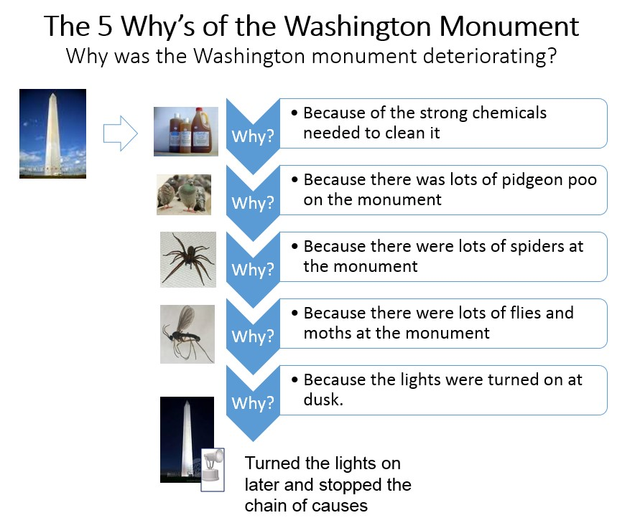
Source: http://www.rch.org.au/uploadedImages/Main/Content/quality/Washington%20Monument.jpg
Notes:
Example of exercise to help determine root cause.
(Can give example of something from their unit.)

Slide 22
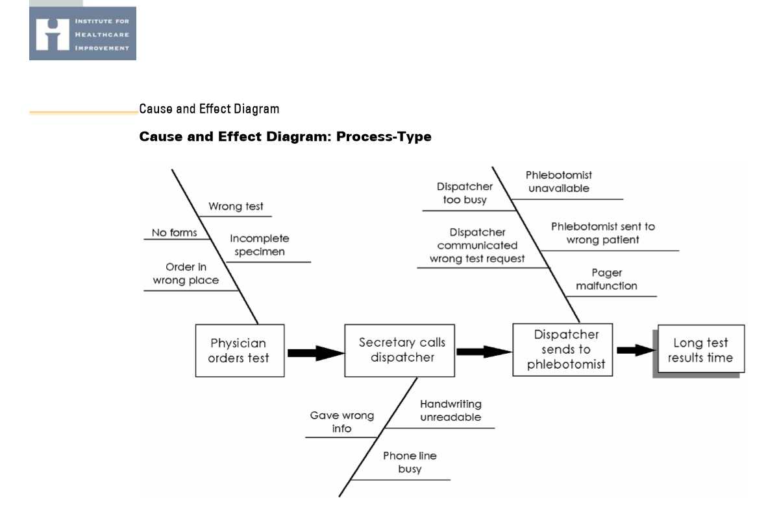

Slide 23
Group Discussion 3 (7 minutes)
Use the 5 boxes below to sketch a high level work flow from Refill Request to Patient picks up Rx. Hint- some steps are outside the primary care practice.
5 minutes to work on process flow, 2 minutes to report out
How could we include patients somewhere?
How would you pick an area to improve?

Slide 24
Using the Model for Improvement
Time: 20 min
Cumulative 59 min

Slide 25

Using the Model for Improvement Framework (MFI)
Answer what are we improving, how much, by when.
To increase/decrease XXX by ZZ% by YY date.
Sample measurement
Number of XXX
Total number of XXX
Team to provide test ideas.
PDSA =
The Plan-Do-Study-Act (PDSA) form can be used when you get here
Developed by: Associates in Process Improvement
Notes:
Need to know baseline before you can increase or decrease by xx%

Slide 26
The three MFI questions
MFI questions | Sample answers
1. What are we trying to accomplish? | Aim Statement - Decrease duplicate Rx refill requests (calls/efaxes) by 50% by XX/XX/XXXX.
2. How will we know that a change is an improvement? | Measurement Number of Calls/Faxes per unique refill
3. What changes can we make that will result in an improvement? | Team to provide test ideas.
Notes:
“Some is not a number.”
“Soon is not a time.”
“Hope is not a plan.”

Slide 27
The PDSA Cycle for
Learning and Improvement
Act
Plan
Adapt?
Adopt?
Abandon?
What’s the
next cycle?
Objective Questions
& predictions (why).
Plan to carry out cycle
(who/what/where/when).
Next cycle?
Study
Do
Complete the
analysis of the data.
  Compare data to
  Predictions.
    Summarize what
    was learned.
Carry out the plan
(on a small scale).
Document problems
and unexpected
observations.
Begin analysis.
W.E. Deming referred to this as the Shewhart Cycle

Slide 28
Repeated Use of the PDSA Cycle
Changes That Result in Improvement
Sequential building of knowledge under a wide range of conditions
A
P
S
D
Spread
DATA
D
S
P
A
Implementation of Change
A
S
P
Wide-Scale Tests of Change
D
Hunches Theories Ideas
A
P
S
D
Follow-up Tests
Very Small Scale Test

Slide 29
Group Discussion 4 (10 minutes)
Three discussion 2-3 minutes each, then report out (Coaches, remember your tasks!)
4A. Write an Aim Statement (Hint: what/how much/by when).
4B. Brainstorm a test idea (Hint: if we do x, will y happen?) (How could you include a patient?).
4C. What would you measure?

Slide 30
What did Karen and Tom test?
When Karen and Tom saw the data, they decided to contact the small pharmacy.
Much to their delight, the pharmacy was eager to cooperate and surprised there was a problem.
Test idea – for 1 day, pharmacy would only send in scripts every 24 hours as long as it is a routine non-narcotic refill. Pharmacy added a caveat – if patient is standing there at pharmacy then they will call.
Notes:
Their “prediction” was that the pharmacy would not want to work with them.
Karen said, “They are use to being yelled at by patients all the time. Give them a chance to be happy, too.”

Slide 31
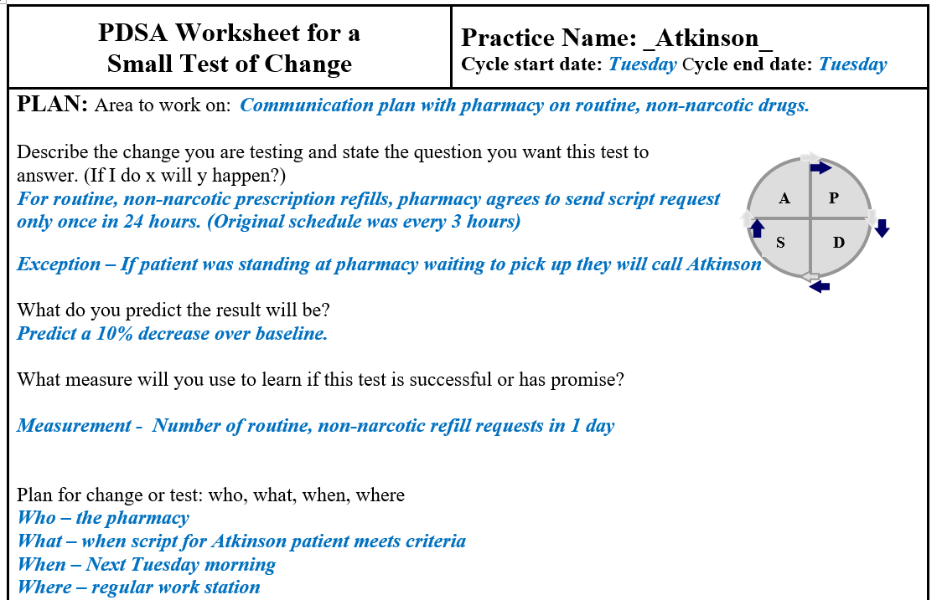
Sample PDSA Form - 1

Slide 32
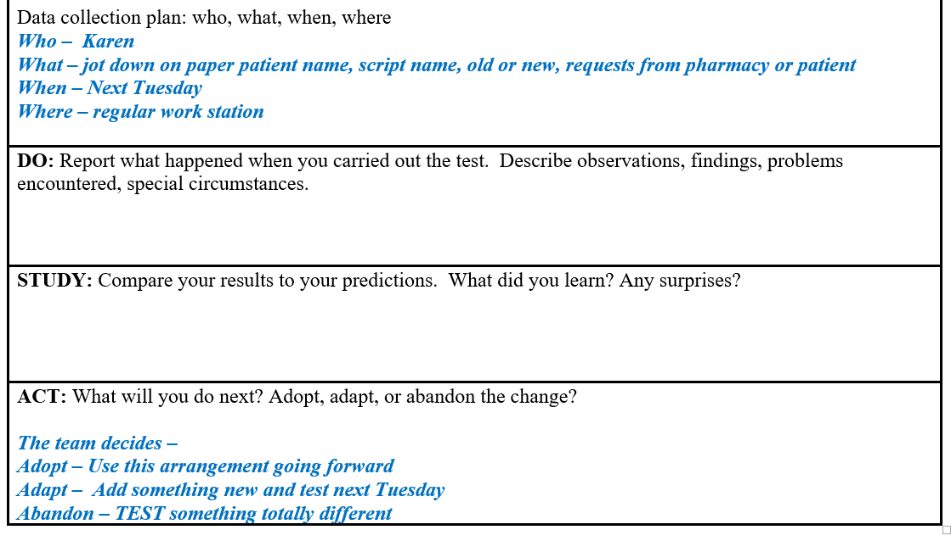
Sample PDSA Form - 2

Slide 33
Sustaining Change
Continuous Improvement
Time: 15 min
Cumulative 74 min

Slide 34
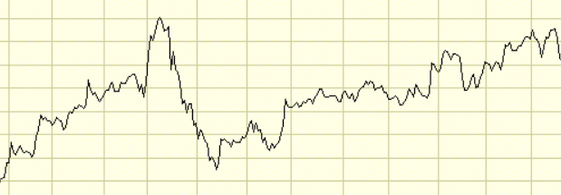

How to make it stick
Someone monitors progress
Run charts – number of duplicates for the same refill over time
Standardize work, check lists
Staff turnover…systems change….

Slide 35
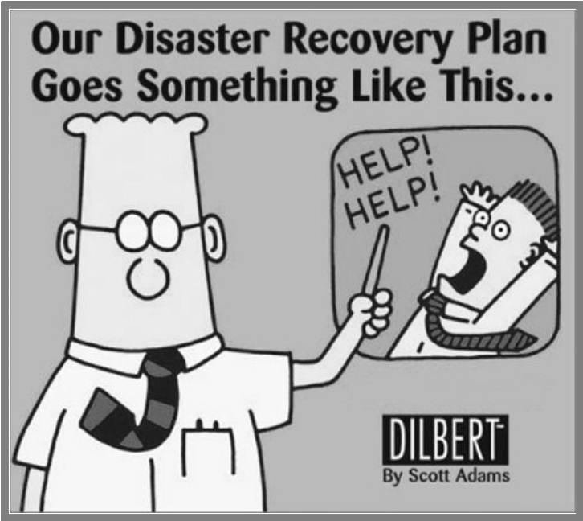
Backup Plan
If the first line of checking fails, what is the second line of defense?
Example: We ask that if you
don’t hear from us in 3 days
please call us for your test
results.

Slide 36
Hierarchy of Sustaining Change
Weakest
Policies,
training,
inspection
ASK: does the change depend on well meaning person or well designed system?
Minimize
consequences of errors
Make errors visible
Make it easy to do the right thing
Make it hard to do the wrong thing
Eliminate opportunity for error
Strongest
Standardization & Simplification
Doug Bonacum, Kaiser Permanente

Slide 37
Summary
Going from a hunch that something could be improved to actually making a change…that sticks…
What is the problem?
Collect baseline
High level flow chart
MFI framework
Sustain
What keeps you up at night?
Collect just enough data
Construct a high level flow chart
Pick a subset
Involve
patients
Last step- Pts
receive the correct follow-up.
Aims, Measures, Changes
Did you involve patients?
Use the PDSA form
Where are you on the pyramid? Does the change depend on well meaning person or well designed system?
D
A
T
A

Slide 38
Group Discussion (25 minutes)
After walking through this example and participating in the group discussions, what are your next steps for your project at your practice?
Ideas: - Patient Safety as the first topic at staff meetings.
- Record “pain points” and patient safety problems for future work
- Involve patients in work to improve safety.

